Slide 1
Module 4: Describing Chemical and Physical Changes
Chemical and Physical Changes
Fundamentals of Chemistry Open Course

Slide 2
Learning Objectives | Module 4
Distinguish between chemical and physical changes, particularly in equations containing chemical formulas.
Interpret chemical equations to visualize chemical reactions or physical changes.
Determine whether a given chemical equation is balanced or not; balance chemical equations.
Apply chemical equations to determine the outcome of a chemical reaction on the submicroscopic level.
Convert a submicroscopic image of a chemical reaction or physical change into a chemical equation.

Slide 3
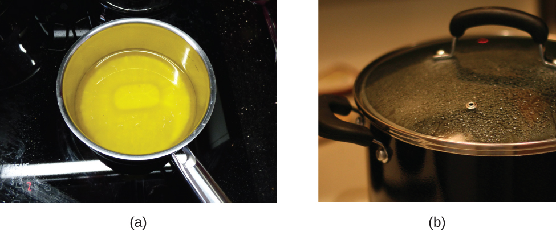
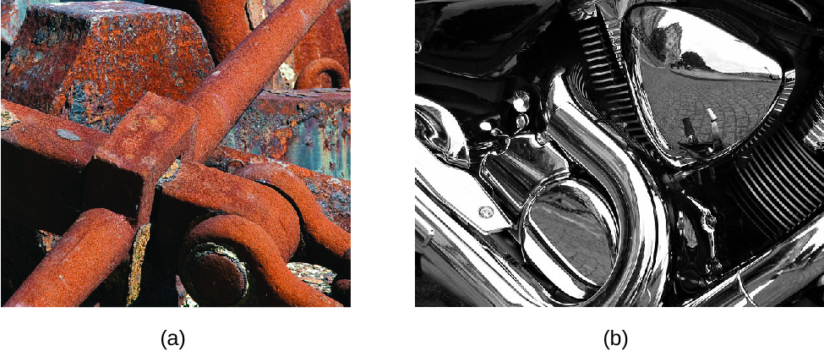
Review. Physical and Chemical Changes
Physical changes alter the state or appearance of matter but do not affect its chemical composition.
Chemical changes (chemical reactions) alter the chemical structure of a substance
by breaking and/or forming chemical bonds.
Melting wax (a) and condensing water (b) are physical changes.
Reaction of iron with oxygen (a) is a chemical change; chromium does not react with oxygen (b).

Slide 4
Chemical Equations | 1 of 2
Chemical equations contain chemical formulas and (usually) phase designators to represent
the state of a chemical system before and after some change.
[initial state] → [final state]
The change may be chemical or physical! Physical changes involve only a change in phase designator—
chemical formulas do not change.
Numbers before each chemical formula (stoichiometric coefficients) represent
the number of formula units involved in the change.
Coefficients reflect the number ratios in which formula units combine in a chemical reaction.
Like a recipe, chemical equations can be scaled. In scaling an equation, we multiply all coefficients
by the same scaling factor. Chemical formulas remain unchanged!

Slide 5
Chemical Equations | 2 of 2
Example. Evaporation of water, a physical change, can be represented as follows.
H₂O(𝓁) → H₂O(g)
Example. Combustion of butane (C₄H₁₀) is a chemical change.
C₄H₁₀(g) + 6.5 O₂(g) → 4 CO₂(g) + 5 H₂O(g)
This equation can be scaled to any level desired…
2 C₄H₁₀(g) + 13 O₂(g) → 8 CO₂(g) + 10 H₂O(g)
1 mol C₄H₁₀(g) + 6.5 mol O₂(g) → 4 mol CO₂(g) + 5 mol H₂O(g)
2 mol C₄H₁₀(g) + 13 mol O₂(g) → 8 mol CO₂(g) + 10 mol H₂O(g)

Slide 6
Lingering Questions
Some chemical substances can react with one another in more than one way. How can we predict the outcome when substances are mixed?
What makes a chemical equation physically plausible? What natural laws must chemical reactions follow?

